Slide 1


Slide 2


Slide 3

Panel 1: Central Valley Workforce Vital Signs
Brent Orrell, Senior Fellow, AEI
Josh Wright, Exec. VP of Growth, Lightcast
Greg Wright, Associate Prof. of Economics, University of California, Merced

Slide 4

Social Capital in Tulare County
Brent Orrell
Central Valley Workforce Policy Summit
American Enterprise Institute

Slide 5

Social Capital Index
Includes metrics of societal health including…
Family unity
% of births to unmarried women
% women married 35-44
% children in single parent homes
Community Health
  Volunteering
  Attending public meetings
  Serving on committees
  Working with neighbors
  Being part of an organization
Institutional Health
  Voting rate
  Census response rate
  Confidence in institutions

Slide 6
Social Capital in Summary (Tulare & Surrounding)
Social Capital Rankings*
Tulare
9th percentile
Fresno
7th percentile
Family/Marriage in Tulare County*
Tulare: Family Unity*
36th percentile
Kings: Family Unity*
33rd percentile
Institutional Health*
Tulare
9th Percentile
Kings
6th percentile
Kings
6th percentile
Fresno
7th percentile
*Percentiles refer to national rankings, 100th percentile being the best and 0 being the lowest measure
Source

Slide 7
Education in Tulare
Literacy: PIAAC* score 231/500¹
High School Graduates: 73.5%²
College Graduates: 15.6%²
Compared to US 264/500
*Program for the International Assessment of Adult Competencies designed to collect information on cognitive and workforce skills.
Compared to CA 257/500
Compared to US 89.1%
Compared to CA 84.4%
Compared to US 34.3%
Compared to CA 35.9%
1 https://nces.ed.gov/surveys/piaac/skillsmap/
2 U.S. Census Bureau QuickFacts: Tulare County, California

Slide 8
Crime and Drugs
Violent Crime Rate: 381.8 per 100,000 people¹
14 drug overdose deaths per 100,000 people²
Incarceration rate: 1,243 per 100,000³
Compared to US avg. 204.5
Compared to CA 495⁴
Compared to US 27 per 100,000
Compared to CA 22 per 100,000
Compared to US avg. 827
Compared to CA avg. 625
¹violent crime rate
²https://www.countyhealthrankings.org/health-data/health-factors/health-behaviors/alcohol-and-drug-use/drug-overdose-deaths?year=2024&county=06107
³Tulare County, California | Incarceration Trends | Vera Institute of Justice
⁴Crime Trends in California - Public Policy Institute of California (ppic.org)

Slide 9


Future Ready Workforce
Central Valley Workforce Summit

Slide 10
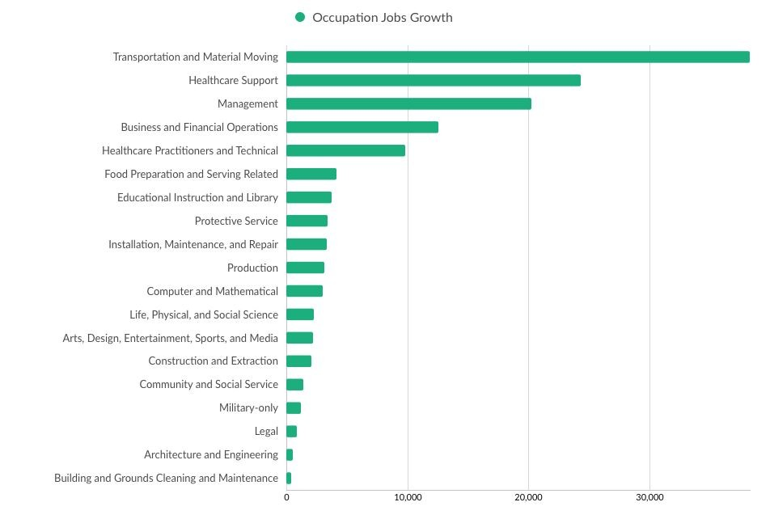

Robust growth in transportation & healthcare support
2018-2023 job growth Source: Lightcast

Slide 11
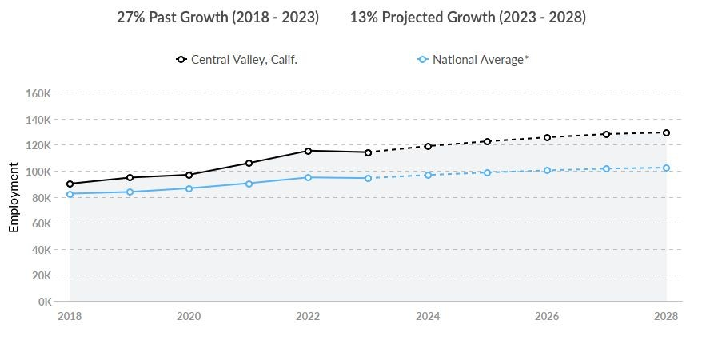
Distribution and e-commerce a growing cluster
Source: Lightcast

Slide 12
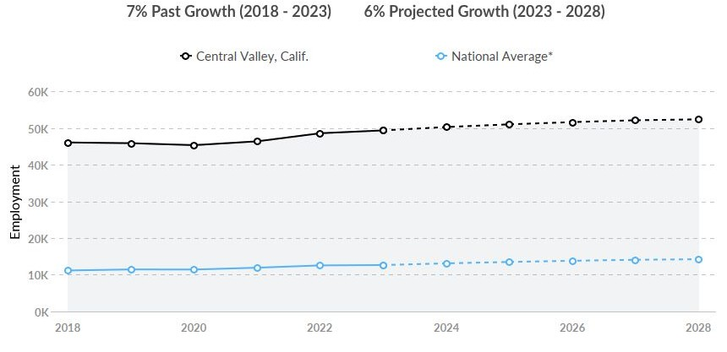
Food processing & manufacturing cluster is a powerhouse
Source: Lightcast

Slide 13

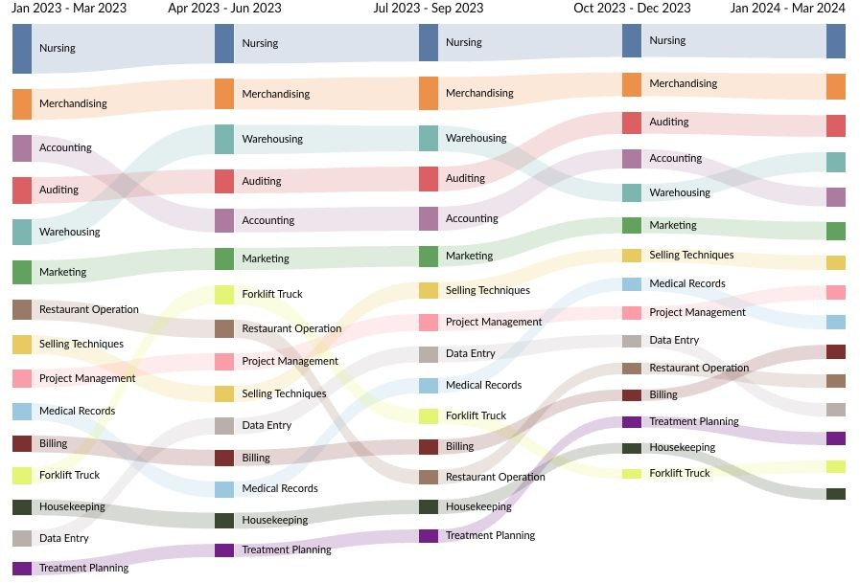
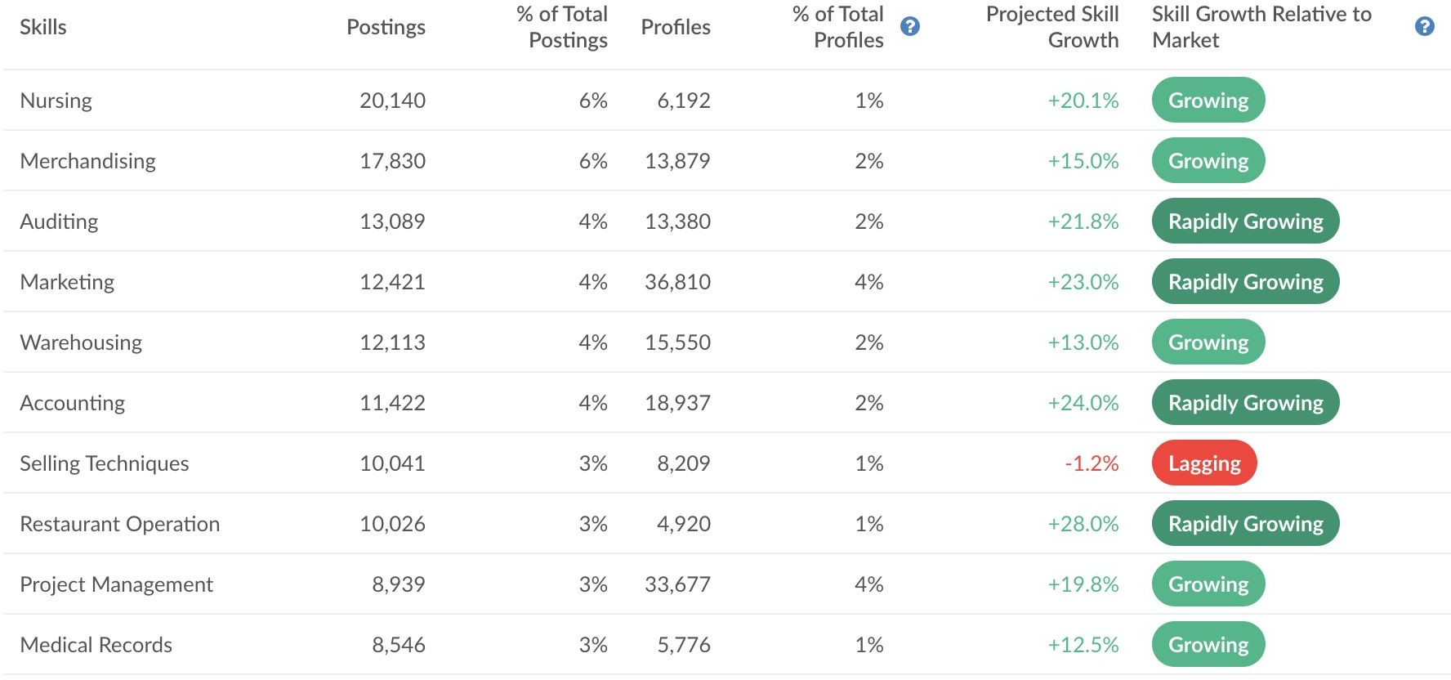
In-Demand and Growing Skills
Regional Overview
Source: Lightcast job posting analytics

Slide 14
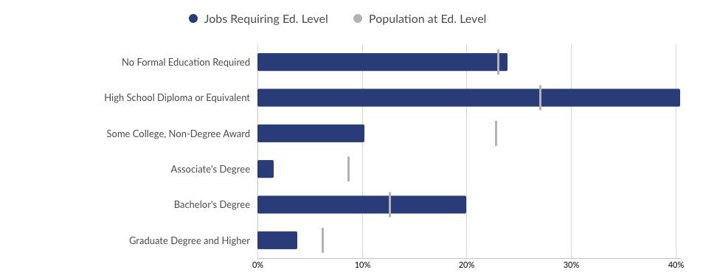
Concern / Opportunity:
Underemployed Segment of population
Source: Lightcast

Slide 15


SCAN
Josh Wright
josh.wright@lightcast.io
To download the
“Who Is Going to Do the Work”
report from Lightcast

Slide 16
Future of the SJV Workforce
Broad shift to a two-tier services economy is hard on places like the SJV
  Manufacturing as a development strategy made more difficult
Could get harder: automation + second China shock
“Defensive” policies: strong minimum wage, labor protections
“Offensive” policies:
  Prepare the existing workforce for high-wage services: education and training
  Attract new high-wage workforce from LA and Bay Area: invest in amenities
  Build a portfolio of new clean energy technologies: leverage cheap land and ag
    Unclear what employment impact will be

Slide 19
Panel 2: Skills Training: What Works
Brent Orrell, Senior Fellow, AEI
Kadeem Noray, Research Associate, Harvard University
Ben Wildavsky, Visiting Scholar, University of Virginia

Slide 20


Sector Programs:
The evidence, and open questions
Richard Hendra

Slide 21
Sectoral Training Programs
For decades, employment programs designed for low-income individuals have not shown impacts on wages and long-term earnings. Sectoral training programs are breaking this pattern.
Sectoral training programs offer
Training skills that are useful for a specific industry with local demands and opportunities for advancement
Strong relationships with employers (dual-customer orientation)
Integration of technical and professional skill training
Focus on higher wage sectors and ‘stretch jobs’
Wraparound support services to encourage program enrollment and completion

Slide 22
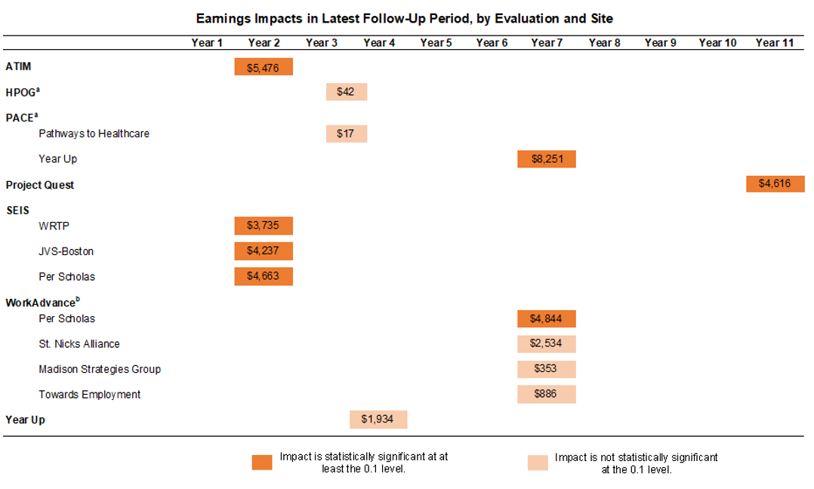

Slide 23
Which program components are most critical?
Not much evidence is available on the effectiveness of individual program components. Possibilities based on successful programs include:
  Strong employer relationships: Deep, ongoing, real involvement w/program
  Identification of high-quality, attainable sector jobs is critical (aim high: jobs w/in reach w/training)
  Thoughtful and well-informed screening processes, which increases the likelihood that participants succeed in the program
  Integration of technical and professional/transferrable skills training
  Wraparound support services (e.g., childcare assistance, financial support), which help participants overcome barriers during training
  Credential receipt, which makes participants more qualified job candidates

Slide 24



Why do sector programs work?
Focus on transferrable skills increases human capital
Wraparound services may help to dismantle discriminatory barriers
Providers are more attuned to changes in demand for different skills and can adapt programs accordingly

Slide 25
Impact Variation in Sectoral Job Training: Evidence from Year Up
Kadeem Noray, NBER & Harvard University
Namrata Narain, Harvard University

Slide 26
Can Job Training Help the Most Disadvantaged?
Context: ↓ income mobility + low earnings growth for the poor
Can job-training be a bridge to opportunity for those who are stuck?
  Impacts from job-training are underwhelming (Card, Kluve, & Weber, 2018)
  Sectoral job training, however, is more promising (Katz et al. 2022)
But, little is known about who these program work for or why?
Determines the extent to which they can help the most disadvantaged
Notes:
One potential answer to this question is job-training programs, which makes the motivating question behind this paper, “can job training programs bridge the opportunity gap?” There is a long history of research in economics and across the social sciences evaluating various job training programs and historically the evidence has been underwhelming. The most comprehensive meta-analysis of this research comes from Card, Kluve, & Weber 2018, who analyze results from over 200 evaluations of job training programs in OECD countries and find zero to small impacts on earnings and employment on average, and, further, very little evidence that the typical training program can more people into high quality jobs (high paying + good non-pecuniary benefits).
More recently, however, evaluations on sector-specific training programs have been more promising. What distinguishes these programs is that, rather than trying to builds general skills or focusing on the the employment margin independent of job quality, these programs focus on training workers specifically in skills that are demanded by high-paying employers in sectors that consistently demand labor. Many of these programs have relationships with local employers whose needs they orient their training curricula toward and some, like the one I am going to focusing on, offer internships with local employers. The short term impact evaluations of these programs have shown earnings increases upwards of 50%, which is basically like getting the return to a BA in ¼ the time.
Despite this, surprisingly little is known about who these programs work for and why they work, which is the focus of my paper. Specifically, I am going to try and answer two overarching research questions: (1) is there systematic variation in impacts of these programs and (2) if so, which mechanisms best explain this variation (aka why/when do these programs work)?
This matters for at least two policy-relevant reasons. (1) Who the program helps will determine whether these programs really can be bridges to opportunity for the most disadvantaged and (2) figuring out which elements of the program govern success determine how to efficiently scale these programs.
170 Seconds

Slide 27
This Project
Setting:
Use RCT of Year Up to study impact variation and mechanisms
  Sites: Atlanta, Boston, Chicago, NYC, Providence, San Francisco, San Jose, Seattle, and DC
Methods & Findings:
Use machine learning to estimate variation in three-year earnings impacts
  Finding 1: Large impact heterogeneity (top ⅕ gets 3x earnings boost relative to bottom ⅕)
  Finding 2: Lowest impact group are disproportionately black, female, and poor
Study explanations of earnings impact variation
  Finding 3: Impact explained by changes in job sector, not measured skills
Notes:
Alright so back to this project, the setting is going to be an RCT of a sectoral job training program called Year Up. I’ve decided to focus on this program for three reasons. First, the RCT had a relatively large sample size of 2539 people and a large three year earnings impact, which means there is power to explore heterogeneity. Second, unlike other programs, part of this RCT was an in-depth survey to assessment of skills both at baseline and shortly post program, which I will leverage to try and learn whether skill growth can explain the programs earnings impacts. And third, due to a data partnership between Opportunity Insights at Harvard University and Year Up, I also have access to internal data on participant progress within the program, which will allow me to explore the potential role of program drop out in explaining effect variation.
What we do in the the paper is the following. First, we use ML (specifically causal forests) to estimate three-year earnings impact variation. From this there are two key results. First, we find evidence of “large” impact variation, where those in the top fifth of the impact distribution get three times the earnings boost relative to those in the bottom fifth of the distribution. Second, we find that those that stack up at the bottom of the impact distribution are disproportionately black, female, and poor, which suggests that the program is less effective for those in historically disadvantaged groups.
Second, we use ML to explore the link between program impacts on various potential mediators and three year impacts on earnings. Specifically, we estimate effect heterogeneity on measures of career skills, character skills, and the quality of job one gets placed in. Then we show that earnings impacts can be explained by impacts on quality of job placement, not growth in measured skills.
140 seconds | intro is 11.5 minutes

Slide 28
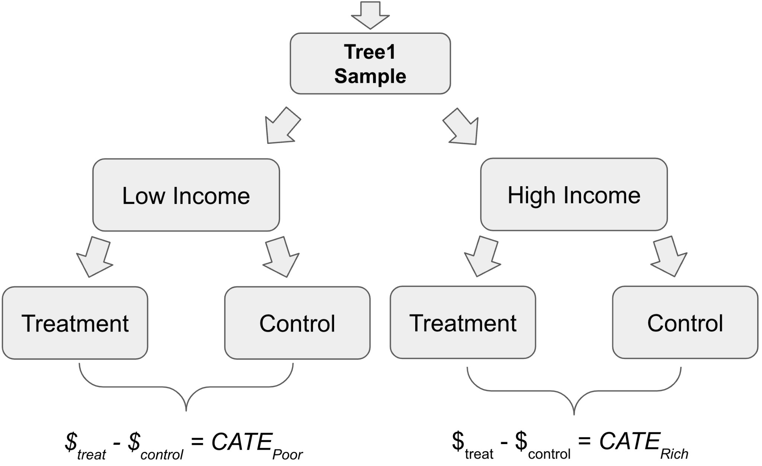
Full RCT Sample
Forest Sample
Hold-Out Sample
Estimating the Causal Forest
Output
Function that predicts impacts
Validation
Predict impacts for Hold-Out Sample
Verify predictions are correlated with actual impacts
Apply Forest
Predict for
Full RCT Sample
Apply Forest

Slide 29
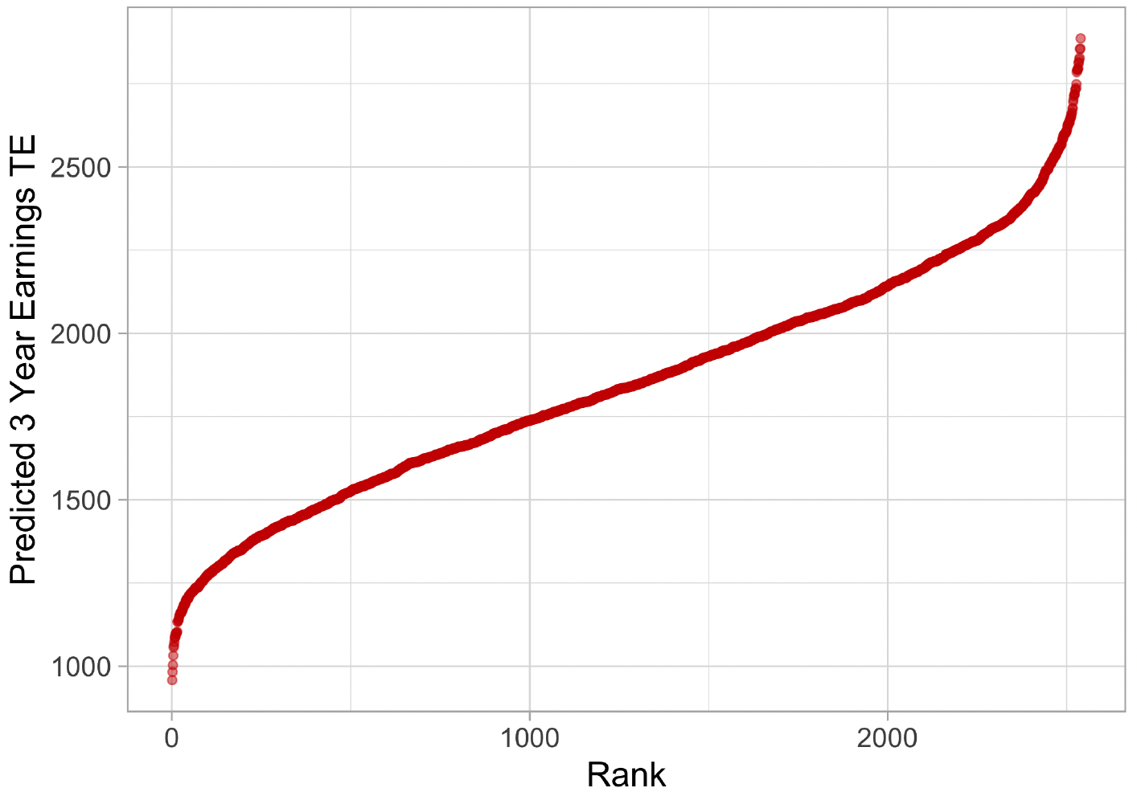
Wide Variation in Quarterly Earnings Impacts
Notes:
Next, I now apply the causal forest predictions to the entire sample, now that I have evidence that the approach is valid. What’s interesting here is that I can even get predictions for individuals who did not respond to the three-year survey because they have baseline data, and that’s all that is used to generate the predictions. So here I am showing the full distribution of predicted treatment effects for the sample.
20 seconds

Slide 30
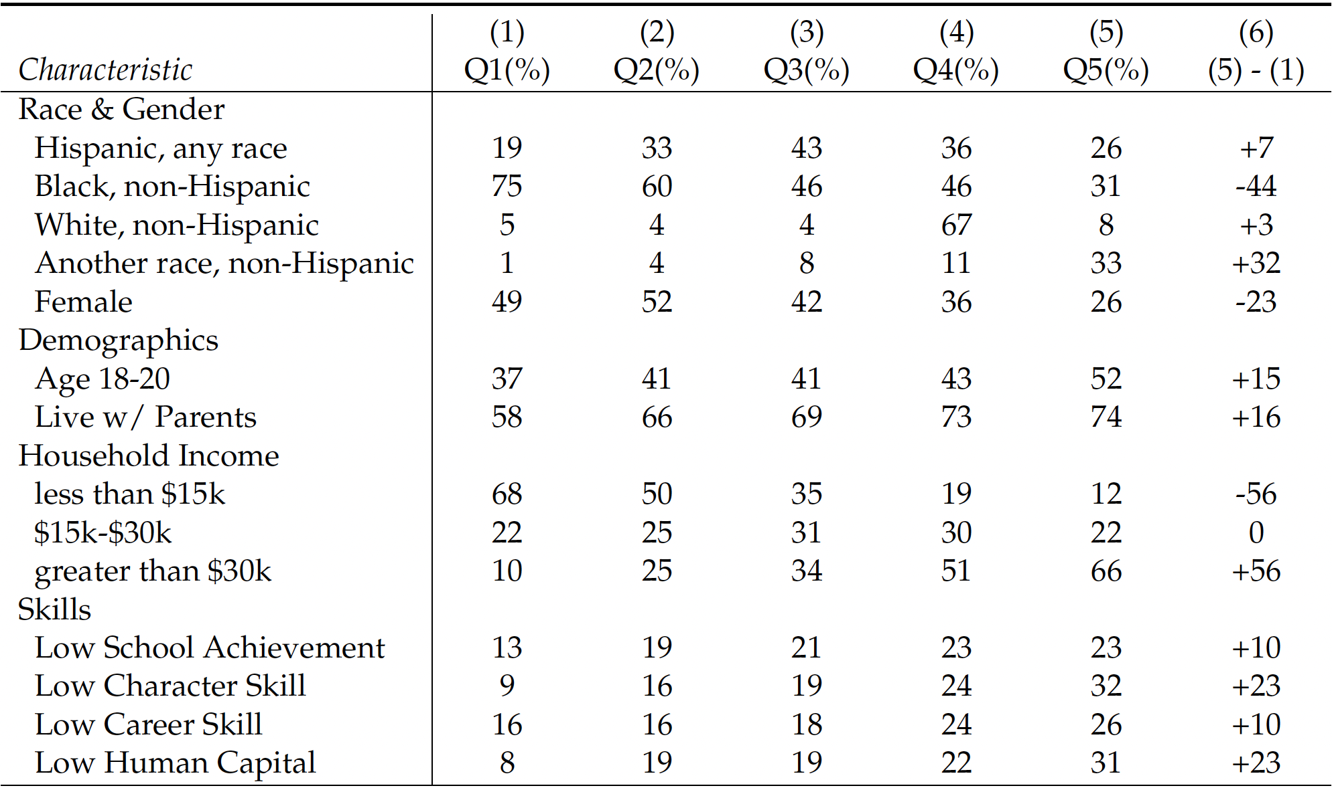
Characteristics by Impact Prediction Quintile
Notes:
Next, I break the sample into quintiles of the treatment effect predictions and describe them demographically. In columns 1 through 5 I look at characteristics of quintiles 1 through 5 of the earnings effect predictions. Column six looks at the difference between the top effect quintile and the bottom effect quintile to see which demographics are over (or under) represented at the top relative to the bottom of the impact distribution.
The first thing to point out is that black people disproportionately stack up at the bottom, being 44 percentage points less likely to be in the top quintile relative to the bottom. This is primarily offset by asians who are 32 pp more likely to be in the top effect quintile. Women, are 23 pp less likely to be in the top quintile and those in the poorest group are 56 pp less likely to be in the top quintile. Finally, the top effect group also appears to be lower skill than the bottom effect group. When I initially saw this, I was confused, but this appears to be driven by women who score higher on the skill measures than men.
The headline takeaway from this, and one of the key findings from the paper, is that those at the bottom of the effect distribution for YU are disproportionately poor, black, and female.
94 seconds

Slide 31
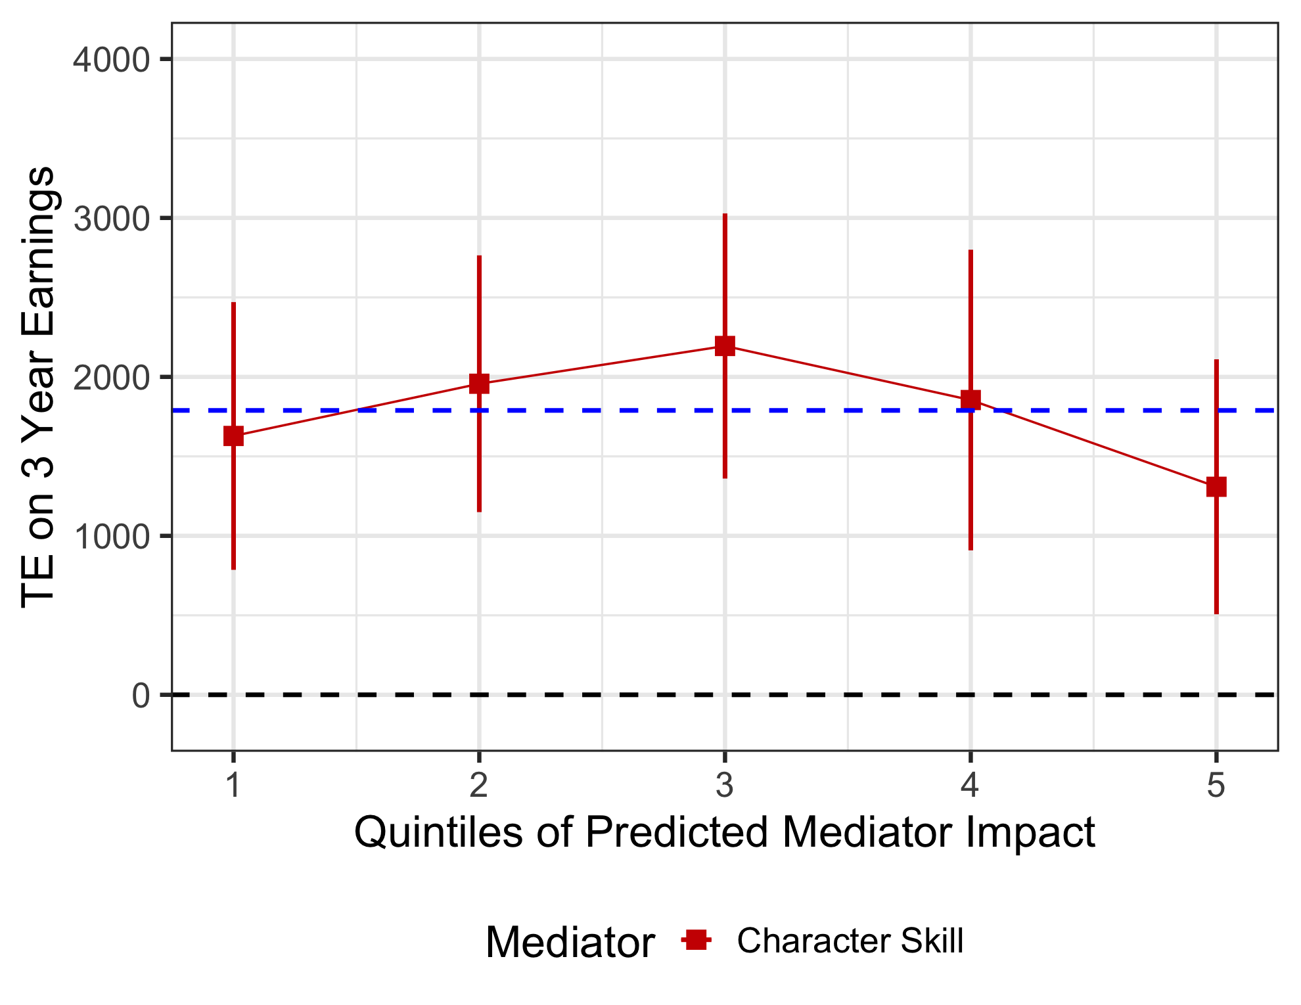
Relationship between mediator impacts and earnings impacts
Notes:
We can perform that same exercise as before, where we look at whether those who are low in the impact distribution on career skills have lower three years earnings impacts than those near the top of the distribution. Then I do this, we again get a flat relationship. This means that, though the program increases these skills on average, those who get relatively high increases in career skills from the program don’t seem to get any higher earnings increases at the three year mark.
40 seconds

Slide 32
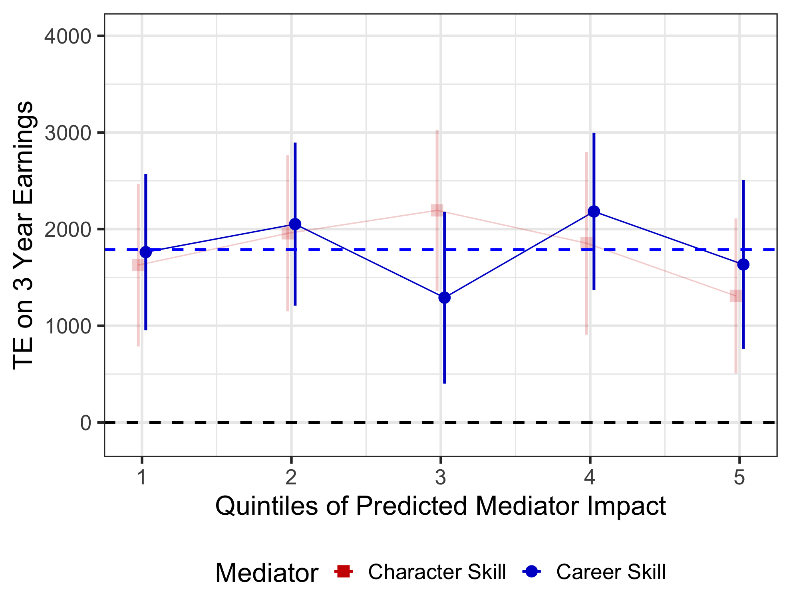
Career skill growth also not related to higher earnings

Slide 33
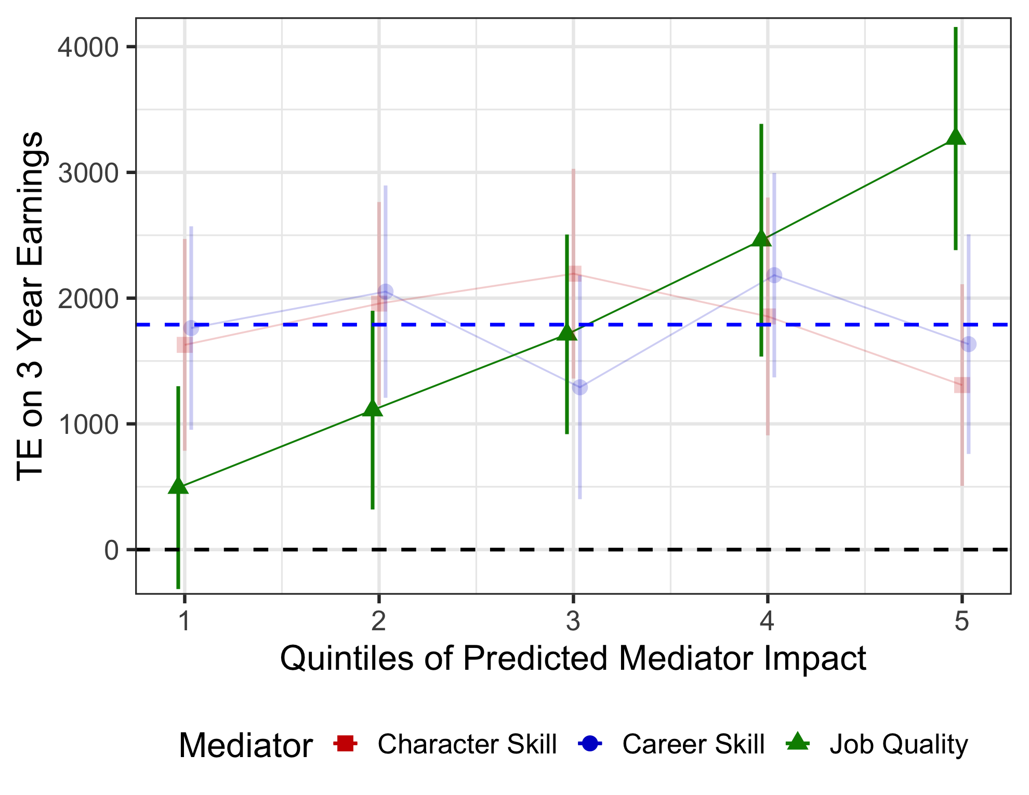
Those who are shifted into target sectors earn more

Slide 34
Conclusion
Revealed wide variation in earnings impacts from YU
Though YU is helping a negatively selected group overall, those in historically disadvantaged groups within this population are overrepresented at the bottom of impact distribution
Implies an “equity-effectiveness” tradeoff faced by Year Up
Impacts best explained by changes in job sector, not measured skill growth
Moving forward
  What role does program drop-out play?
  Can results be used to better screen-in participants necessary baseline skills?
Notes:
93 seconds | 43 minutes

Slide 35


Slide 36
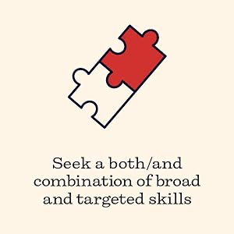

Slide 37


Slide 39
Panel 3: Building a Stronger, More Inclusive Workforce System
Matthew Amidon, Contractor, American Enterprise Institute
Mason M. Bishop, Nonresident Fellow, American Enterprise Institute
Anne Kim, Senior Fellow, Future Ed
Ken Troske, Richard W. and Janis H. Furst Endowed Chair, University of Kentucky Galton College

Slide 40
Government-Supported Job Training in the US: The Workforce Innovation and Opportunity Act Moving Forward
Kenneth Troske, Peter Mueser
Comments by Brent Orrell

Slide 41
Federal training programs start in 1962 with Manpower Development Training Act (MDTA)
  Designed to retrain workers affected by trade and technological change
Since start of JTPA funding in real dollars, or as a share of GDP, has fallen significantly
  Decline seems related to studies showing training programs are not effective
  Administrative costs consume a larger share of dollars, leaving fewer dollars for training programs
Recent research shows more positive impacts for training programs, particularly for disadvantaged workers
  Sectoral training programs seem particularly promising, along with online training
This research supports increasing funding for training programs

Slide 42
Need a more flexible system
  Reduce reporting requirements for getting someone eligible for training
  Eliminate distinction between economically disadvantaged workers and dislocated workers
  Clearer guidelines and funding responsibilities for Job Centers
Create separate training structures for workers looking to enhance existing skills and those facing significant barriers to employment
  Adopt innovative sectoral training programs and greater use of online training, more stringent performance standards for those enhancing existing skills
  Devote resources and develop new strategies to training hard-to-serve populations and adjust performance standards
Provide incentives for WDB directors to seek alternative sources of funding to support training programs—particularly the hard-to-serve population

Slide 43
Earmark dollars to fund rigorous studies of what types of training works best for different populations of participants and why
  Focus on developing new data resources and on sharing administrative data with researchers and across state lines
  Help local WDBs develop, understand and implement effective evaluations
  Focus on what works for people being trained, not cost-benefit analysis
Create a more collaborative system with federal, state and local officials working together
  Frontline workers at local WDB have the most information about what works, yet their voices are seldom heard when developing policies
  Include officials from local WDB in all evaluation efforts
Research shows additional funding for training programs is warranted. But the system need to become more flexible and creative, and needs rigorous evaluation to determine what works and what doesn’t.

Slide 44


Central Valley Workforce Summit
Laboratories of Democracy:
Modernizing the Workforce Development
Costs
Prepared By:
Mason Bishop
AEI Nonresident Fellow
Materials used in developing this PowerPoint include the Employment and Training’s “One-Stop Comprehensive Financial Management and Technical Assistance Guide” and WIOA Notice of Proposed Rulemaking (NPRM) issuances.

Slide 45
Why Is It Important?
Currently 9 million unfilled jobs nationally (BLS)
Just over 1 out of 5 states have labor force participation rates under 60 percent (FRED)
“By 2031, 72 percent of jobs in the US will require postsecondary education and/or training.” (GCEW)
“Between 2021 and 2031, there will be 18.5 million job openings per year on average, and some 12.5 million of these annualized openings will require at least some college education.” (GCEW)

Slide 46
Identifying the Problem
The federally-funded public workforce system is broken.
It is not an issue of funding—level of appropriations does not overcome inefficient and poorly designed governance and system delivery architecture.
State education, workforce, and social services agencies receive billions in appropriations for dozens of programs from a multitude of federal agencies.

Slide 47
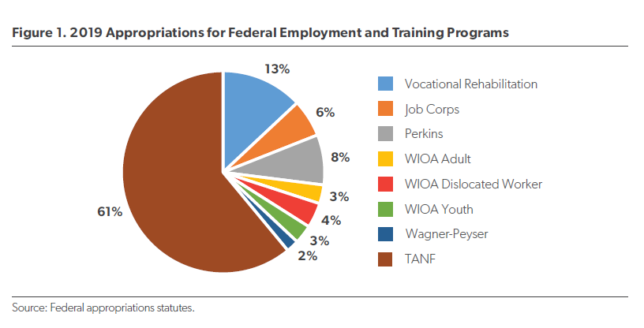
Program Integration

Slide 48
The Utah Model
Integrated Service Delivery:
1. Goal: One “True One-Stop Door” in Communities-In Utah, all one-stop centers and virtual service delivery is provided by DWS. Job seekers/workers only have to go to one place to receive services
In most communities in U.S., there are up to three or more doors—(1) “one-stop WIOA/WP center”; (2) social services office-TANF, SNAP, Medicaid, etc. (3) Vocational Rehabilitation
Utah has single, integrated case management system whereby all case managers, regardless of program, manage a participant’s case file. Employer services are integrated, as well.

Slide 49
The Utah Model
Integrated Service Delivery:
Vision: Develop a One-Stop System “Franchise Model” whereby the state ensures (1) efficient and effective service delivery, and (2) consistent service delivery by integrating and operationalizing the suite of federal/state-funded employment and training programs.

Slide 50
WIOA Reauthorization
New Demonstration Authority
Modeled after the Section 1115 waiver authority that led to federal welfare reform based upon state innovation.
H.R. 6655 is the House bipartisan WIOA reauthorization bill that contains new demonstration authority
ISSUE: Limited to a handful of states with population under 6 million and LFP under 60%.
Senate likely to consider expanded authority to more states.

Slide 51
WIOA Reauthorization
New Demonstration Authority
Unique opportunity to innovate at the ground level and design service delivery systems that work best.
Provides the incentive to negotiate among stakeholders at the state and local levels to redesign systems
Opportunity to build in the flexibility that will be needed in an age of AI and automation.
Better align resources coming through postsecondary education with workforce training resources.

Slide 52
Contact Information
Mason Bishop
mason@workedconsulting.com
703.209.7890
AEI Publications:
https://www.aei.org/profile/mason-m-bishop/

Slide 53

How well is WIOA serving women?
Central Valley Workforce Summit
April 16, 2024

Slide 54
Significant gender wage gaps despite similar employment rates
Median wages (2022) | Men | Women | Female/Male earnings ratio | Employment Rate (4Q)
WIOA Adult | $9,275 | $7,446 | 80.2% | 69.9% (M) 73.4% (F)
Dislocated Workers | $10,232 | $7,800 | 76.2% | 72.5% (M) 74.3% (F)
Youth | $5,026 | $4,284 | 85.2% | 72.6% (M) 75.1% (F)
Wagner-Peyser | $9,096 | $6,909 | 75.9% | 66.3% (M) 68.2% (F)
Source: Department of Labor, PY 2022 WIOA National Performance Summary

Slide 55
Lack of access to childcare
Childcare is an allowable service for WIOA supportive service funds, but too costly to be a common option
Share of participants receiving “supportive services” (including child care) in PY2021:
  Adult: 18.3%
  Dislocated workers: 9.2%
Federal Child Care and Development Fund subsidies reach only 1 in 6 eligible children
Sources: Department of Labor; Department of Health and Human Services

Slide 56
Occupational segregation
Women make up:
Women only make up:
85% of child care workers
  Average hourly wage: $14.60
90% of certified nursing assistants (CNAs)
  Average hourly wage: $14.41
18% of STEM occupations
  Median annual wage: $60,000
14% of apprentices
  Average wage at program completion ($77,000)
4% of construction and extraction jobs
  Average hourly wage (construction): $37.56
Sources: BLS; FRED; Center for American Progress; National Science Foundation; DOL

Slide 57
Popular sectoral strategies are often male-dominated
Top 5: Manufacturing, IT, Construction, Logistics, Health Care
Women face unique barriers to retention and advancement:
  Professional isolation - ”the only one”
  Exclusion from informal networks and opportunities to build social capital
  Harassment
  Unequal standards – Work twice as hard to be considered half as good
Women in STEM (2024 survey):
  18% told to “smile at work”
  45% have never been promoted
  40% were “talked over” in meetings
Women in trades (2021 survey):
  48% felt held “to a different standard”
  27% “always or frequently” harassed
Sources: STEM Voices; Institute for Women’s Policy Research; MyBioSource

Slide 58
Recommendations
Improve access to childcare – increase funding for supportive services; flexibility to access CCDF
Ensure advising and career coaching services don’t inadvertently reinforce occupational tracking
Seek out partnerships with model employers that prioritize parity

Slide 60
Panel 4: The Future of the Agriculture Workforce
Vincent H. Smith, Nonresident Senior Fellow, AEI

Slide 61

Farm Labor in the United States
1948-2022
Vincent H. Smith, PhD
Director, AEI Agricultural Policy Studies Center

Slide 64
Farm Labor, 1969-2022

Slide 65
Farm Operators by Tenure, 1950 – 2022

Slide 66
Thank You!

Slide 67
Background Facts and Notions on Farm Workforce Issues in California
The Central Valley Workforce Summit,
April 16, 2024, Visalia, California
Organized by the American Enterprise Institute, Center on Opportunity and Social Mobility and the Workforce Investment Board of Tulare County
Daniel A. Sumner,
Agricultural and Resource Economics, University of California, Davis and
the University of California Giannini Foundation

Slide 68
A few numbers for farm labor in California
Annual average ~420,000 employment agriculture in California (1/3 of US) 170,000 direct hires in crops
Of these 100,000 in fruits and veg. (35,000 strawberries and 20,000 grapes)
230,000 now hired by “support firms” ... Mostly contractors
830,000 people work in ag at some point and 83% had “primary” earnings from farm work (Half of these worked for contractors)
More than 70% worked for a single employer (but that employer may be a labor contractor, so they worked on several farms).
Most workers are immigrants, few are “migrants.” They work seasonally at jobs within commuting distance from home, but the commute may be long.

Slide 69
Labor Supply-side facts and trends
Many farm workers in the market for part of the year
Farm jobs (at equivalent earnings appeal to only some workers
Farm workers are immigrants (often undocumented)
New immigration to replenish supply remains challenging
Farm labor force is aging, which changes the health and safety issues
Continuing (expanding?) use of farm labor contractors
Formal immigration programs (H2A) benefit large employers and contractors, another drive to larger employers
Smaller farms become less relevant as employers for temporary workers

Slide 70

Milk is the biggest farm industry in California,
90% in the San Joaquin Valley
Year-round jobs for 20,000 workers
Mechanization but robotics not yet ready for a takeover.
Labor 10% of farm costs.
Dairies face economic stress

Slide 71
Labor demand-side situation and trends
1. Growing U.S. and global demand for labor-intensive crops.
2. California regulatory costs are always rising.
3. Wages rise, but inflation lowers real income; cuts in hours, adds to concerns.
California overtime rules reduced hours per week offered during the peak earning season, lowering annual earnings.
4. Higher cost of living for workers, especially for coastal crops.
5. Coastal berry labor demand has grown.
6. Farm labor demand drives farm wages, but non-farm wages dominate.
7. Hired labor remains a high share of costs from some crops

Slide 72
Labor Costs as a Share of Costs for some Crops
Asparagus, Delta: 82% of operating costs; 69% of total costs
Oranges, SJ-south: 67% of operating; 47% of total
Strawberries, organic, CC: 42% of operating; 37% of total
Romaine Hearts, CC: 58% of operating; 47% of total
Proc Tomato, Sac V.: 25% of operating; 21% of total
Almonds: 15% to 20% of operating costs
Table grapes: 60% of operating costs, 50% of total;
Coastal wine grapes: 60% operating, 30% total costs (high land and vineyard costs)
For comparison, Alfalfa: direct labor, 2% of total costs, custom harvest 14% of total costs including machinery.

Slide 73
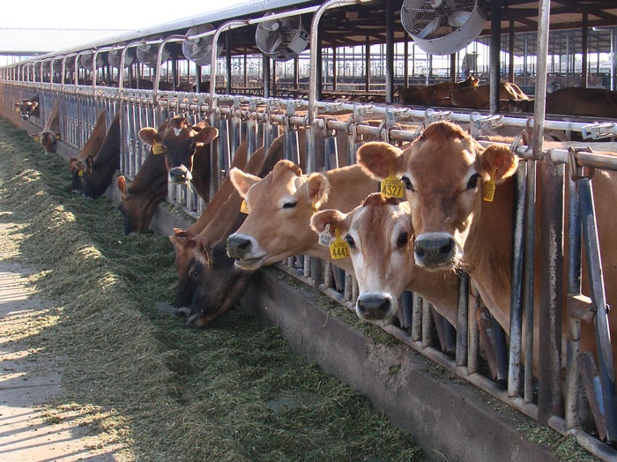

Thank you!

